Slide 1

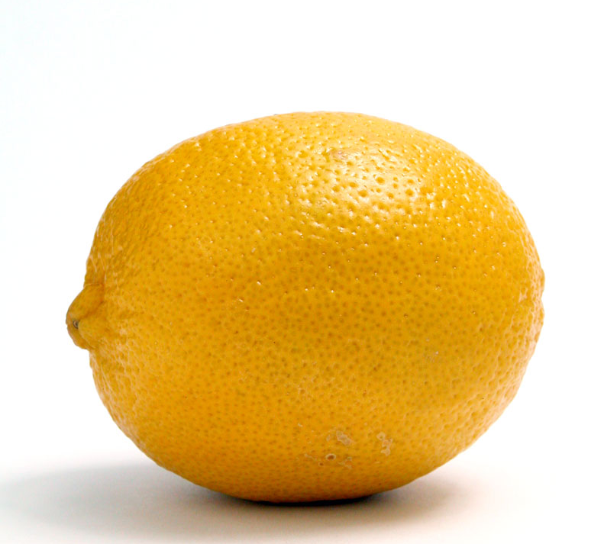
Stored Potential Energy
When life throws you lemons... make electricity.
Notes:
Alright, young humans, gather 'round and let's talk about something super cool: stored potential energy! Imagine you're holding a spring in your hand, all coiled up and ready to boing! That coiled spring is like a little treasure chest of energy, just waiting for the right moment to unleash its power.
Now, in our space adventures with the Blarts, we rely on stored potential energy to zip around the universe in our trusty spaceship. It's like having a stash of energy snacks onboard for when we need that extra boost to escape gravity wells or dodge asteroid fields.
But why is stored potential energy so important for our ship? Well, think about it like this: when we charge up our ship's batteries or compress gas in our propulsion systems, we're storing up energy that we can use later. It's like filling up your tank before a long road trip — you wanna make sure you've got enough juice to get where you're going!
Now, here's where you come in, I need your help to extract the energy from a lemon, build an electric motor and a small electrical generator. With these gadgets, we can harness the power of stored potential energy to make things move and generate electricity. It's like tapping into the universe's own power grid!
I'll provide you with all the parts and instructions you need. Think of it as a little DIY science project. We'll work together, learn together, and maybe even share a few laughs along the way. Who's ready to become space engineers and explorers extraordinaire? Let's do this!

Slide 2

The word Electricity comes from a number of Greek and Latin words for Amber. electr means originate in Latin, elektron which is Greek for amber, and electicus mean "to produce from amber by friction" in Latin.
Ancient Greeks discovered that amber, which is really tree sap (and the stuff they used in the movie Jurassic Park) can store static electricity. While they did not understand electrons at the time, they did know that if you rubbed amber it would attract things like feathers.
The force we now know as magnetic attraction.
Notes:
The term "Electricity" has its roots in several Greek and Latin words associated with Amber. "Electr" stems from the Latin word "electrum," which means amber, while "elektron" in Greek refers to amber as well. Additionally, "electricus" in Latin denotes "to produce from amber by friction.“
The ancient Greeks stumbled upon an intriguing property of amber, actually fossilized tree sap (yes, just like in Jurassic Park!). They noticed that amber could hold onto static electricity, even though they didn't quite grasp the concept of electrons back then. What they did know was that rubbing amber would cause it to attract objects like feathers.
This phenomenon, which we now recognize as electrical attraction, sparked the early curiosity about the invisible forces at play in the universe.

Slide 3





Static Electricity is a charge that will stay in one place.
Take a balloon filled with air and
rub it on your hair or wool sweater. The balloon becomes charged with lots and lots of negative atoms and will then attract or repel all other atoms.
Because the balloon is so light,
the force is enough to make it stick to a wall or to attract long hair.
Charge two balloons by rubbing them on your hair. What happens when we try to put them side by side? Why?
You are now seeing the attraction of atom at work.
Notes:
Static electricity is like a party guest that decides to stick around for a while. Grab a balloon, give it a good rub against your hair or wool sweater, and watch the magic happen! The balloon becomes a magnet for tons of negative atoms, which then go on to play the attraction or repulsion game with all the other atoms around. It's like witnessing the invisible dance of attraction among atoms right before your eyes!

Slide 4

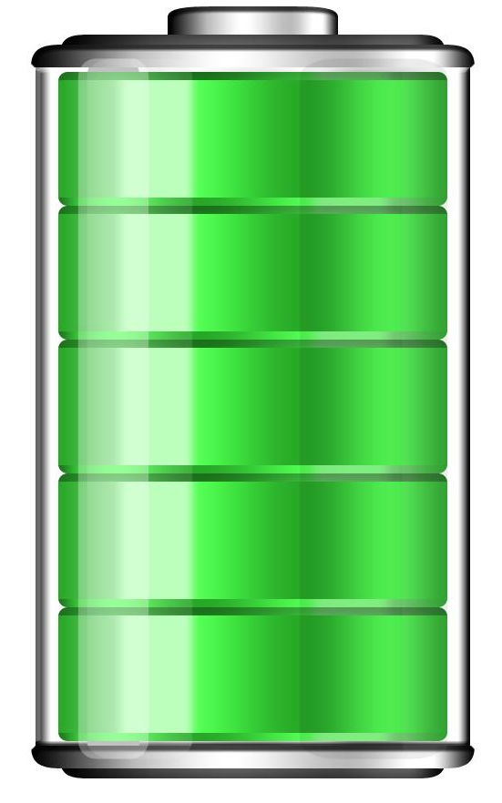
Energy can never be created or destroyed, but it can be saved and stored. A battery is a chemical process for storing electrical an charge.
The best part of the chemistry of batteries is the chemical reaction only happens when we use the battery, so it can store the electrons for a long time.
Notes:
Picture this: energy, like a galactic superhero, can't be created or destroyed, but it sure knows how to play hide-and-seek by saving and storing itself for later adventures.
Now, when it comes to our trusty batteries, they're like little chemists cooking up a storm of electrical magic. They use a nifty chemical process to stash away all that electric mojo until we need it most.
But here's the coolest part about battery chemistry: the magic only happens when we flip the switch or hit the power button. That means our battery buddies can hold onto those electrons for what feels like light-years, just waiting for the perfect moment to shine!

Slide 5
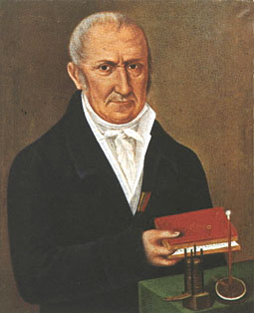
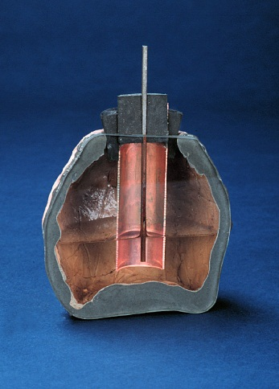
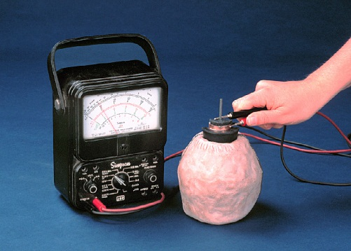
The first modern battery was created in 1799 by Alessandro Volta.
2000 year old jars have been discovered which, when filled with a fluid like vinegar, will make a low voltage charge.
(Not everyone believes these were originally batteries, though.)
Notes:
Back in the day, way back in 1799 to be precise, the ingenious Alessandro Volta rocked the scientific world with the creation of the very first modern battery. But hold onto your space helmets, because ancient jars dating back 2000 years have been unearthed, and get this: when filled with a simple fluid like vinegar, they're like the OG version of a low-voltage power-up! Talk about ancient energy hacks!

Slide 6
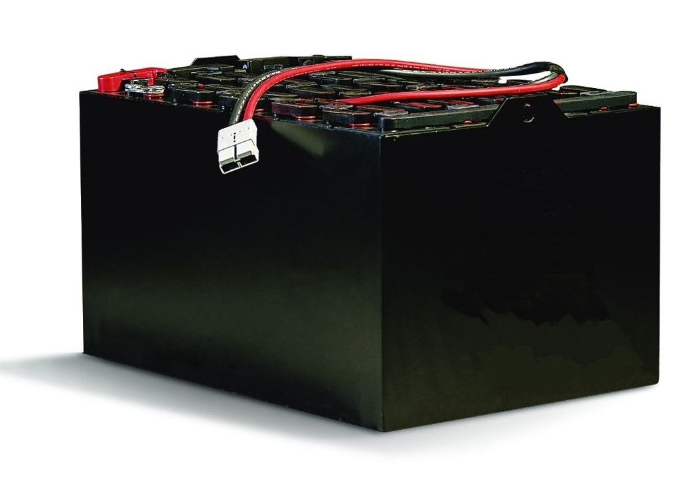
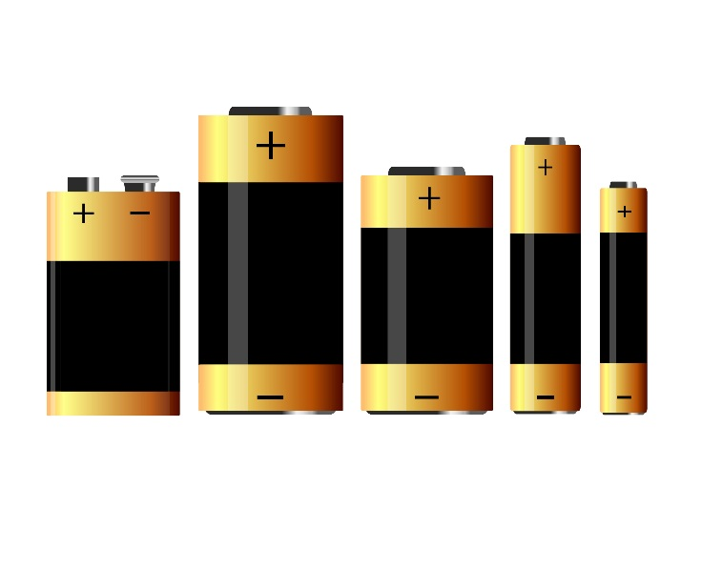
There are many types of batteries, all designed for unique purposes.
When looking at a battery, we look for two specifications Voltage and Amperage: How much pressure and how many Amperes are available for use.
All are 1.5 Volt
12 Volts / 20 Amps
D
C
AA
AAA
9volt
1150 mill-amp
500 mill-amp
2122 mill-amp
17000 mill-amp
7800 mill-amp
Notes:
When checking out a battery, our cosmic checklist zeroes in on two key specs: Voltage and Amperage. Think of it like this: Voltage tells us the pressure, while Amperage gives us the lowdown on the quantity of electrons ready for action. It's like sizing up the horsepower and fuel tank of our interstellar ride!

Slide 7

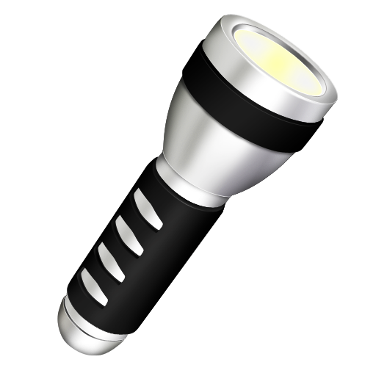
Now we can see why different items use different batteries.
Different devices need different amounts of power. A large device will drain a small battery very quickly, so we need to use a power cell with more Amperes.
All are 1.5 Volt
12 Volts / 20 Amps
D
C
AA
AAA
9volt
1150 mill-amp
500 mill-amp
2122 mill-amp
17000 mill-amp
7800 mill-amp
Notes:
Ah, in the vast universe of gadgets and gizmos, each device has its own hunger for power. Picture this: a big, hungry device gobbling up energy like a cosmic vacuum cleaner. To keep up with its appetite, we gotta hook it up with a power cell packing more Amperes, like serving up a supersized meal to a hungry space explorer!

Slide 8
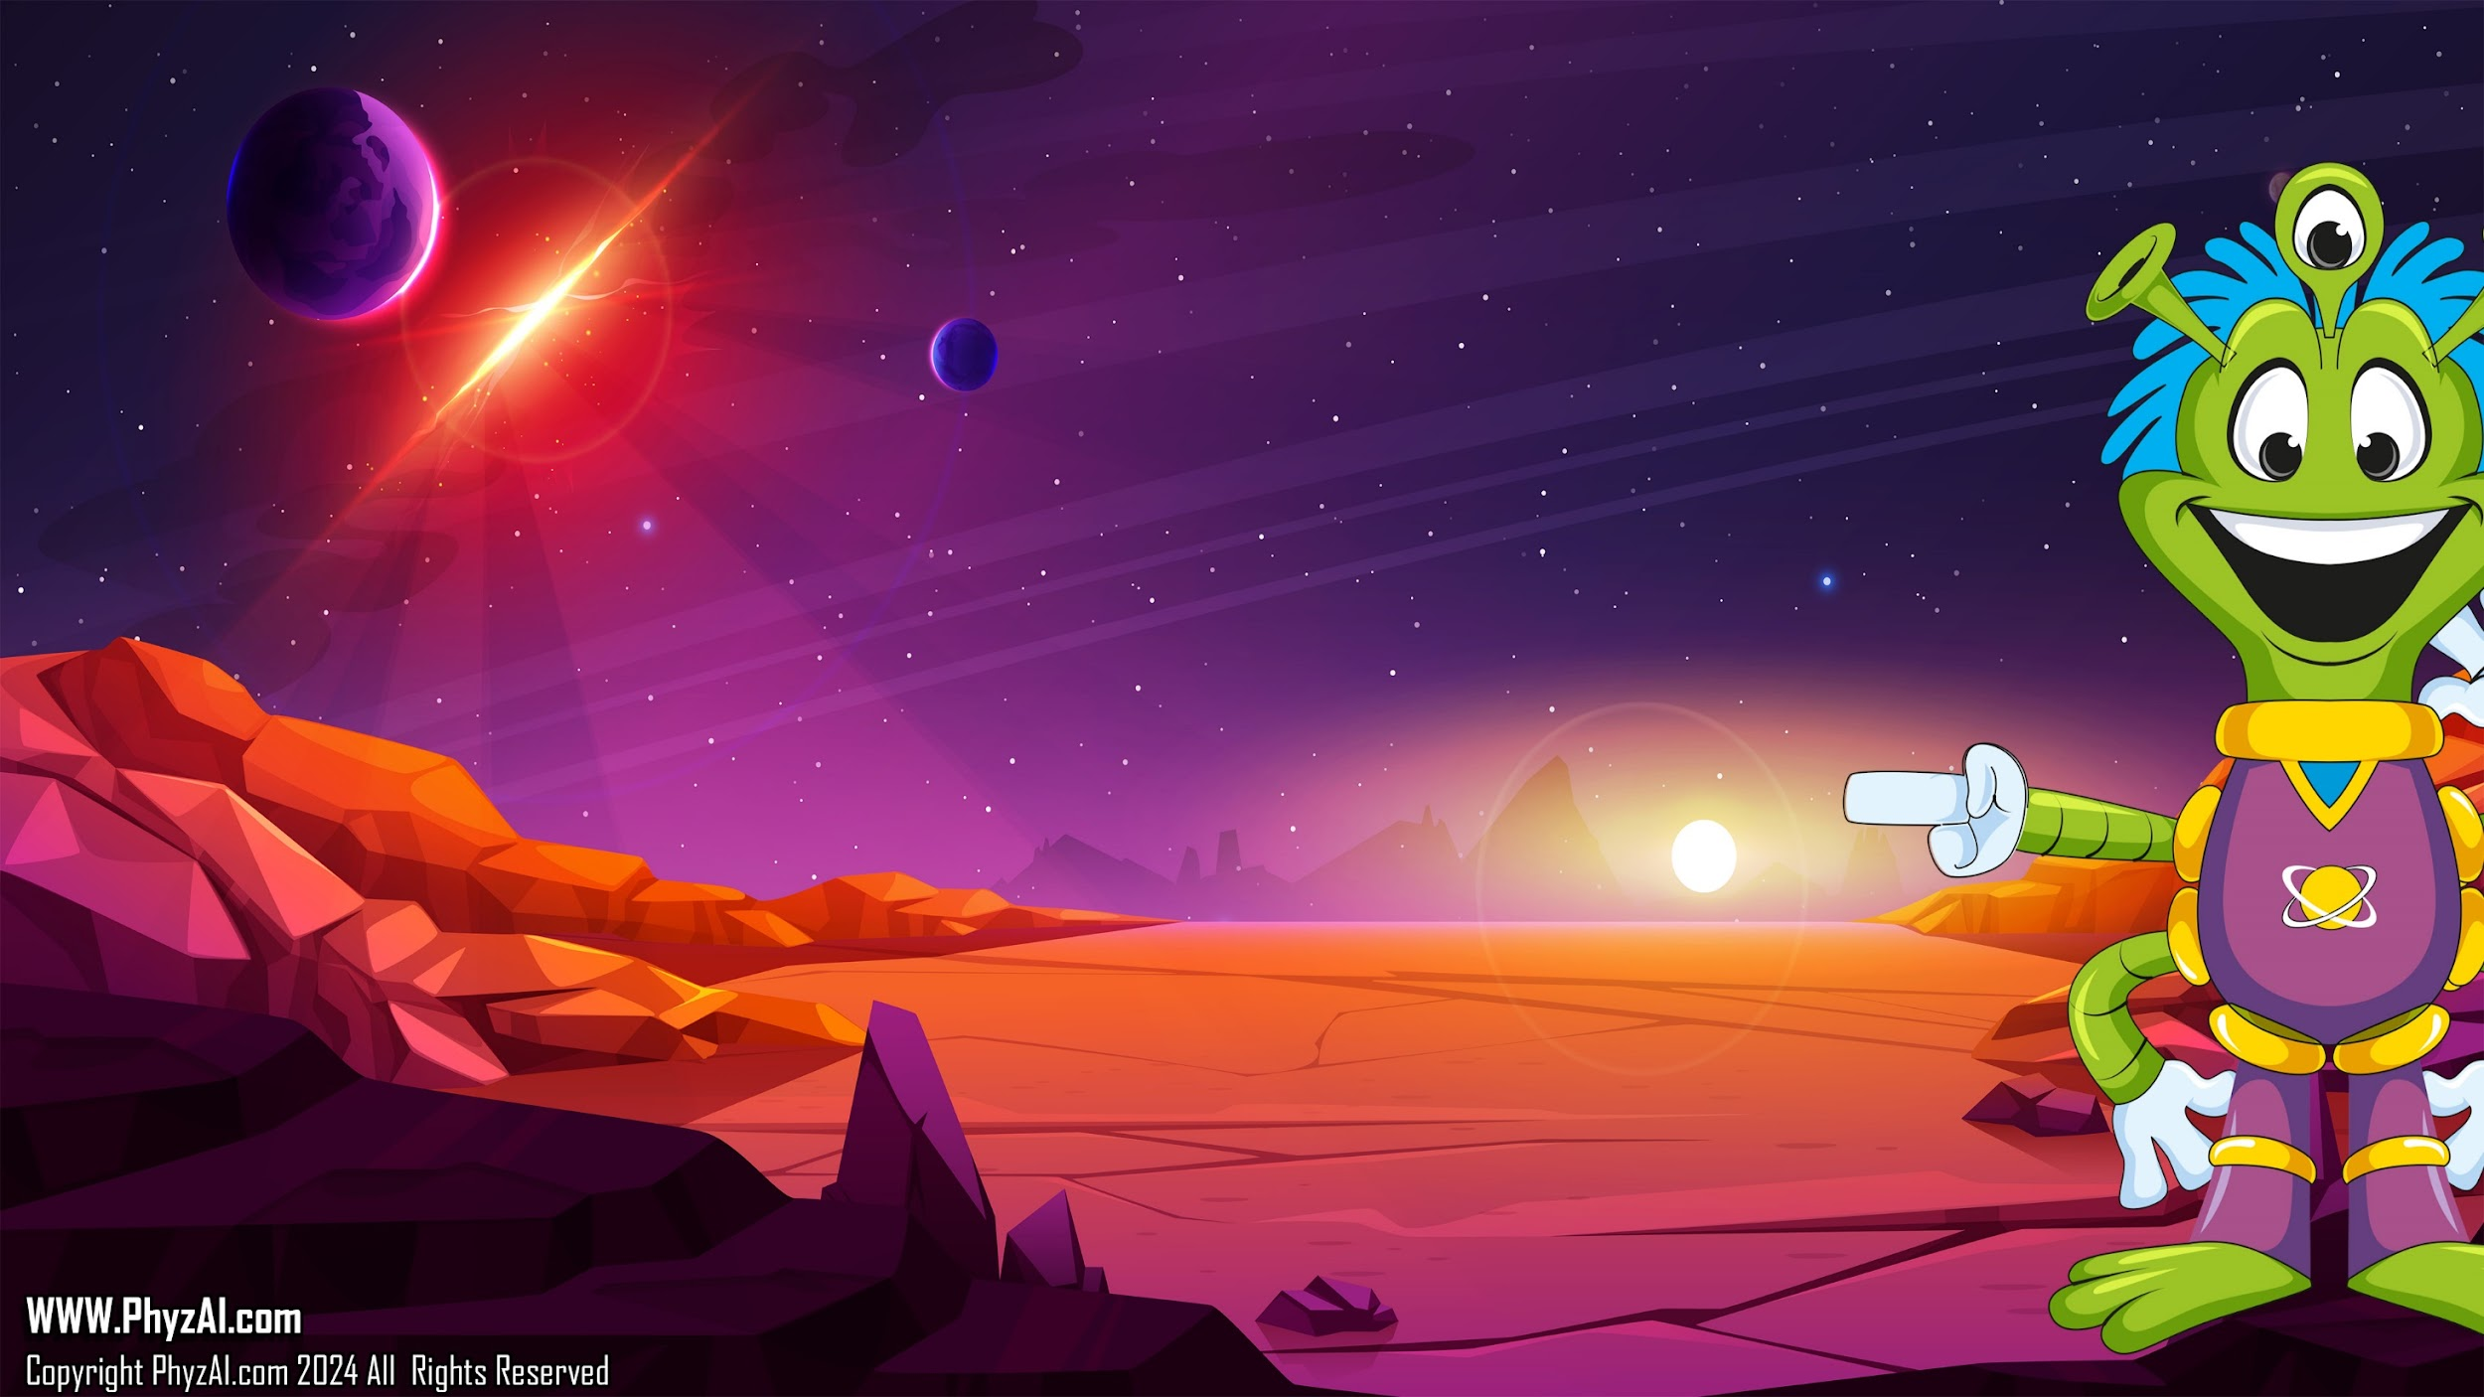
Serial or Parallel
When connecting batteries in a row, we have two choices in how to arrange them: serial or parallel.
Serial combines for to deliver more Voltage, Parallel combines to give more Amperage.
Notes:
When it comes to linking batteries together, we've got two options on our cosmic menu: serial or parallel.
Serial setup teams up batteries in a row to amp up the Voltage, like stacking boosters for an extra kick.
On the flip side, parallel connection buddies up batteries side by side to beef up the Amperage, like joining forces to tackle cosmic challenges together.

Slide 9

Parallel combines to
give more Amperage.
1.5 Volts
Same voltage but the device
will run much longer.
Notes:
When batteries join forces in parallel, they're all about boosting the Amperage. That means the voltage stays the same, but the device gets to run for what feels like light-years. It's like having a marathon runner fueled up for an extended cosmic journey!

Slide 10

Series combines for
to deliver more Voltage.
4.5 Volts
Same amperage but more voltage.
Notes:
When batteries team up in series, they're all about cranking up the Voltage. That means the Amperage stays the same, but the voltage gets a cosmic boost. It's like adding extra rocket fuel to our spaceship's engines, giving us that extra kick to reach for the stars!

Slide 11
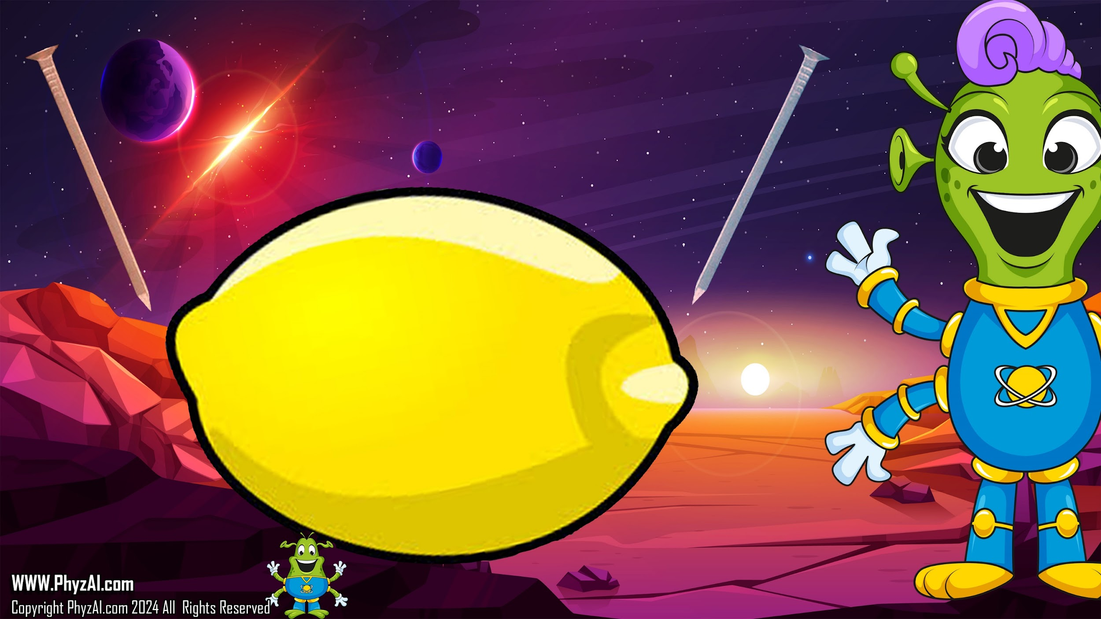
So, let’s make
Lemon Power.
Lemon Power!
Notes:
So lets make some Lemon Power and extract the stored energy from earth fruit and see what happens when do that in Series with other lemons.

Slide 12
Lemons are filled with electrons. And we know how to get them out.
Copper Nail
Zinc Nail
Notes:
Lemons are like tiny electron treasure chests just waiting to be unlocked. And lucky for us, we've got the secret key to set those electrons free!

Slide 13
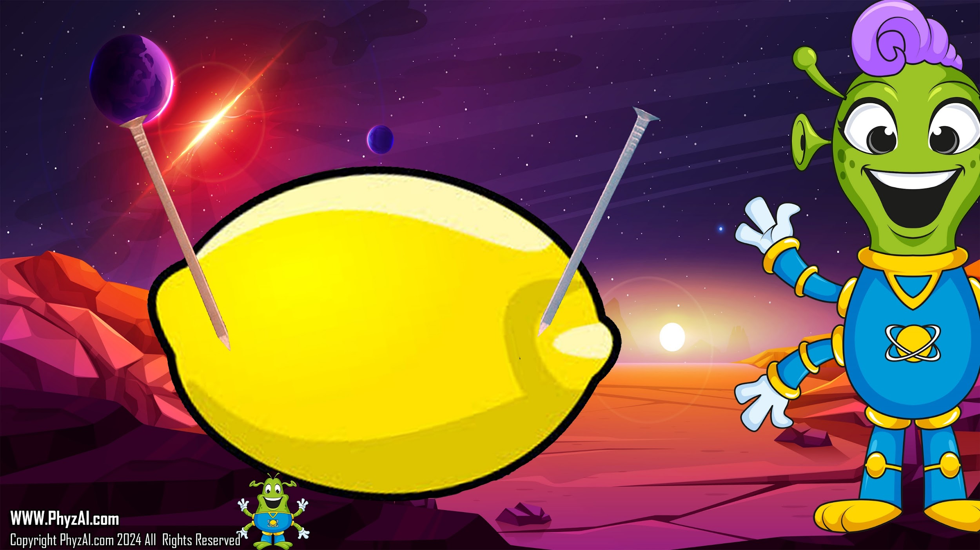
When we insert the nails in to the lemon, the copper nail attracts all the negative electrons
while the zinc nail attracts all the positive ones.
Copper Nail
Zinc Nail
Notes:
When we plunge the nails into the lemon, it's like a cosmic magnet game: the copper nail pulls in all the negative electrons, while the zinc nail snags the positive ones. It's a lemon-powered electron dance!

Slide 14
This makes the Copper nail attract Positive electrons (opposites attract)
and the Zinc nail attract negative electrons.
+
-
Copper Nail
Zinc Nail
Notes:
Now the copper nail, drawn by the laws of attraction, lures in the positive electrons, while the zinc nail plays host to the negative ones. It's like a cosmic dance where opposites not only attract but also create a lemon-powered electrical party.

Slide 15

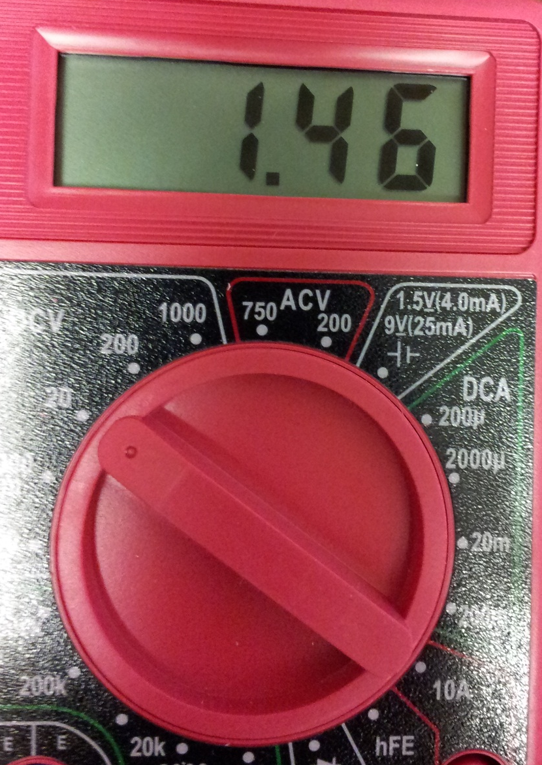
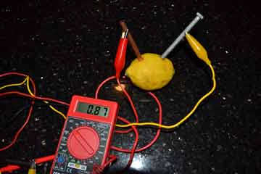
Let’s set our multimeter
to Volts DC and see if
we can get a voltage
reading.
Notes:
Time to gear up our trusty multimeter! Let's dial it to Volts DC mode and see if we can catch some voltage action. It's like tuning in to the cosmic frequency of electric potential!

Slide 16
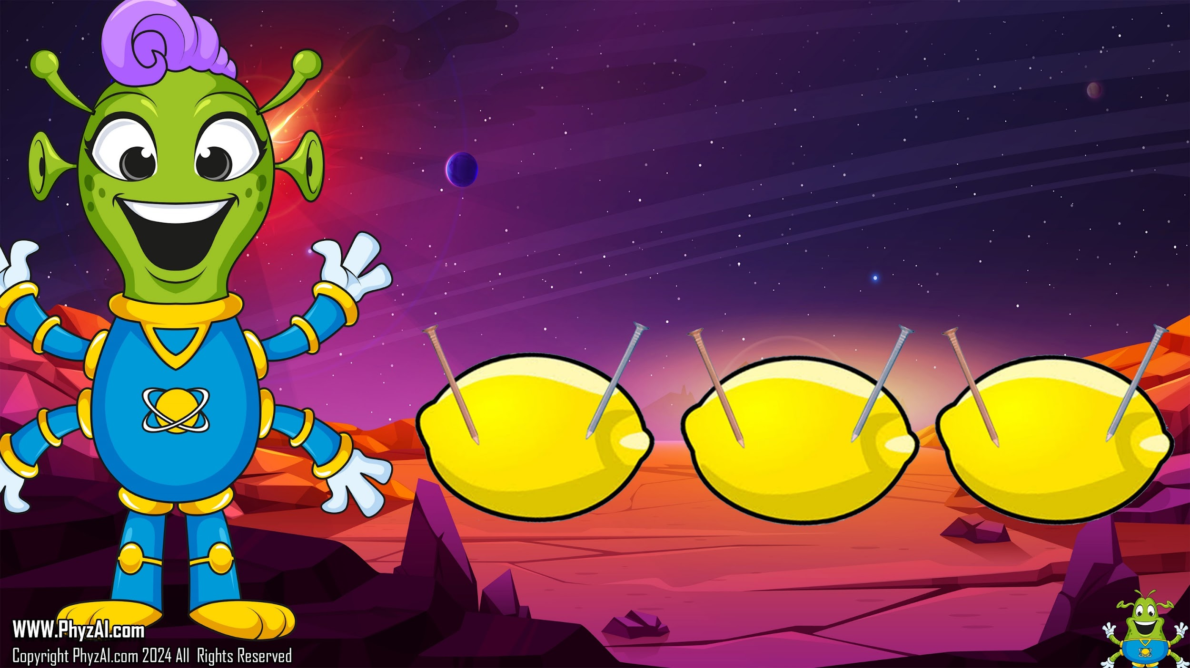
We will need more volts if we are going to light a bulb with lemon power.
We need to connect our lemons in series to get more voltage to our lamp.
Notes:
To light up a bulb with lemon power, we're going to need a voltage boost. That means we'll have to link our lemons together in series to crank up the voltage heading to our lamp. It's like building a lemon-powered ladder to reach new heights of illumination!

Slide 17

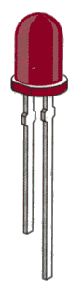
Make sure you connect the Copper (positive) on one memon to the Zinc (Negative) on the next. This will connect the lemons in Series and give you maximum voltage.
Now you can add a light!
We will learn more about LED's next week but for now, an LED is a lamp designed to work with very low voltage.
When connecting the light, make sure to connect the LONG side of the LED to the Copper (positive) Wire from the last lemon.
Notes:
Be sure to link the Copper (positive) terminal of one lemon to the Zinc (negative) terminal of the next. This forms a series connection, maximizing the voltage output.
Now, let's introduce the light! We'll delve deeper into LEDs later, but for now, know that an LED is a lamp tailored to operate on very low voltage.
When connecting the light, remember to attach the LONG side of the LED to the Copper (positive) wire from the last lemon. It's like completing a cosmic circuit to illuminate our lemon-powered creation!

Slide 18
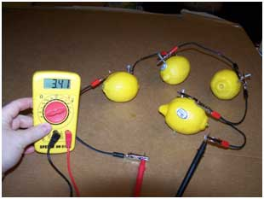
Notes:
Now, let's put the meter to the test and see just how much power we've got. With a bit of luck and plenty of lemons in the mix, we might just see some light! Remember, it might take quite a bunch of lemons, so don't be discouraged if it doesn't work right away. We're on a lemon-powered journey, and sometimes the cosmic recipe needs a bit of tinkering to get it just right!

Slide 19
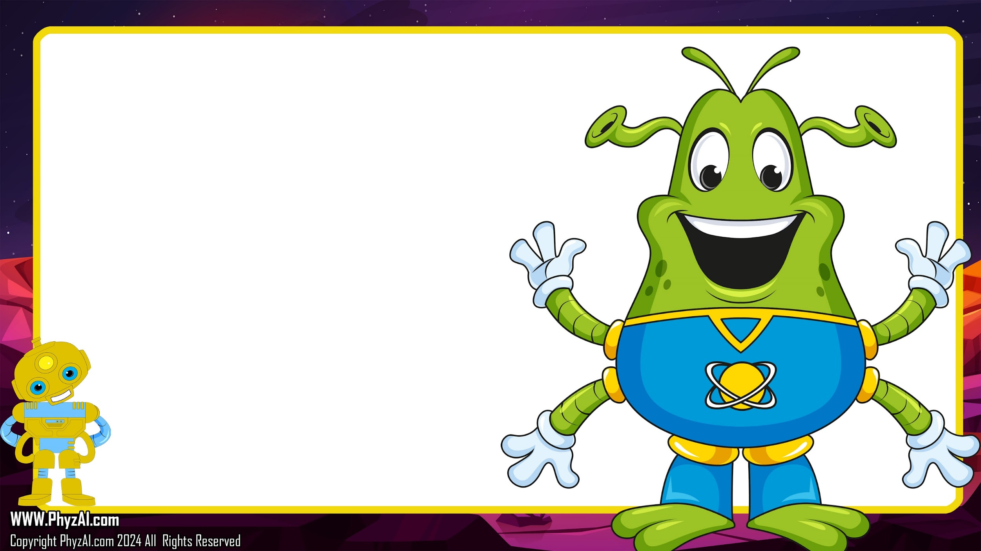

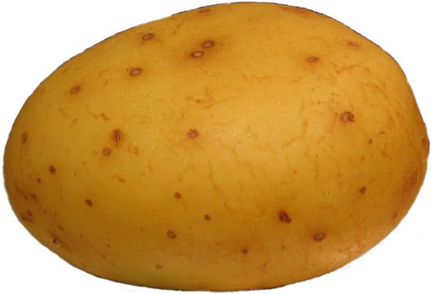
Lets try different vegetables and see what happens.
Notes:
Lemons sure make for an electrifying experiment, but they're not the only ones holding onto those zesty electrons! Ever thought about exploring other fruits or veggies that pack a punch in the electron department? See if you can uncover what they have in common.
Now, I've gotta jet off and lend a hand to the Blarts with some spaceship repairs. Catch you on the cosmic flip side, and keep those science adventures rolling!

